Slide 1


SMART PROPERTY RECOMMENDATION SYSTEM
Project Proposal
Prepared by
Subhrojit Patra
Supported by
Rohit Haldar
Riya Ranjan

Slide 2



MEET THE MEMBERS
The Minds Behind the Magic
Rohit Haldar
Data Analyst
Subhrojit Patra
Team Leader
Riya Ranjan
Full Stack Developer

Slide 3
LIST OF CONTENTS
Current Property Search Landscape
Problem Statement
Proposed Solution
System Workflow
Key Features & Intelligence
Technology Requirements
Expected Outcomes
Conclusion
References

Slide 4






CURRENT PROPERTY SEARCH LANDSCAPE
KOL
HYD
BROKER
BLR

Slide 5

PROBLEM STATEMENT
When people rely on traditional brokers to buy a property, there is a risk of misleading information, hidden charges, or potential scams.
On the other hand, online platforms may present thousands of property options, making it difficult to identify the most suitable one.
WHAT SHOULD WE DO?

Slide 6

PROPOSED SOLUTION
Authentic and verified property information
Broker-free direct owner contact
Only relevant properties, not endless listings
AI/ML-based personalized recommendations
Detailed Information about the property
Safety, connectivity and lifestyle information

Slide 7
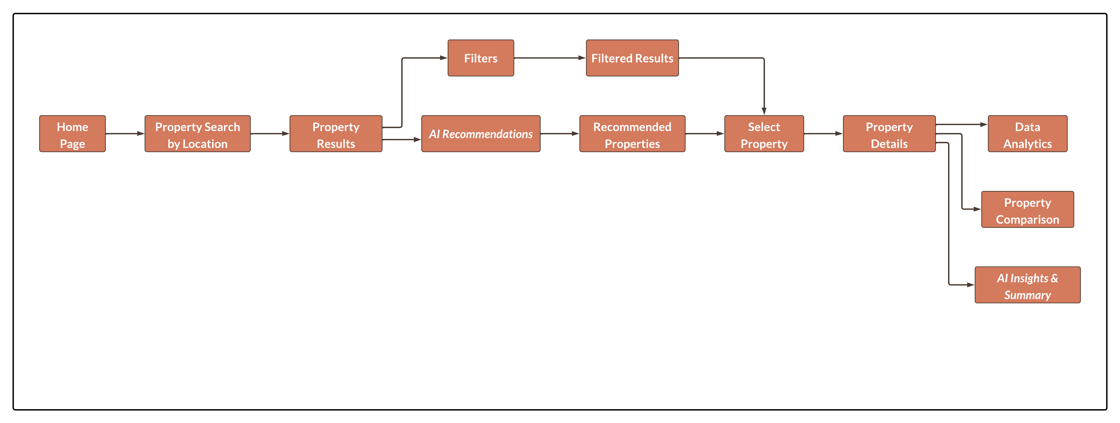
SYSTEM WORKFLOW

Slide 8
KEY FEATURES AND INTELLIGENCE
🔎 Search — Location-based property discovery
⚙️ Filter — Manual or AI-assisted customization
🤖 AI Assistant — Understands user preferences
🏠 Property View — Detailed property information
📊 Analytics — Data-driven property insights
📝 AI Summary — Quick, understandable property analysis
“Less searching. More understanding. Smarter property decisions.”

Slide 9

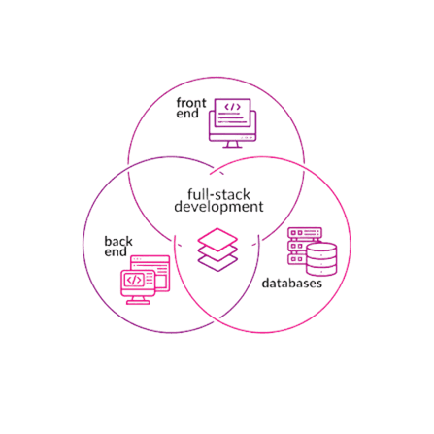

TECHNOLOGY REQUIREMENTS
Full Stack Development
Builds the user-facing platform
UI — Search, Filters & Comparison
Back-end — System & Property Operations
Database & APIs — Data & Connectivity
AI / ML
Enables intelligent property recommendations
User Preference Analysis
Property Matching
Intelligent Insights
Data Analysis
Turns raw property data into insights
Data Preparation
Pattern & Trend Analysis
Insights & Visualization

Slide 10
EXPECTED OUTCOMES
🔎 Easier Property Discovery
Users can find relevant properties faster through focused search and filters.
📊 Better-Informed Decisions
Property details, comparisons, and locality insights help users evaluate options more clearly.
🤖 Smarter Personalization
Optional AI/ML recommendations can match properties with individual preferences and priorities.
💡 Transparent Recommendations
The system explains “Why this property?” instead of giving only an unexplained match score.
🌐 One Integrated Platform
Search, comparison, insights, and intelligent recommendations are brought together in a single platform.

Slide 11
CONCLUSION
Making Property Search Smarter, Simpler & More Transparent
One platform for search, filtering, comparison and property insights
AI/ML adds personalized recommendations based on user preferences
Data analytics helps users understand properties and localities better
A simple, login-free experience keeps property discovery accessible
Designed to reduce search effort and support more informed property decisions
From searching for a property → to understanding the right property.

Slide 12
REFERENCES
Research: Books, journals & research papers on AI/ML, recommendation systems and real-estate analytics
Technical: GitHub repositories, related projects & online documentation
Content & Ideation: ChatGPT & related project references
Design & Visuals: Google Images, Canva & presentation resources

Slide 13

QUESTIONS & DISCUSSION

Slide 14

THANK YOU :)

